Slide 1
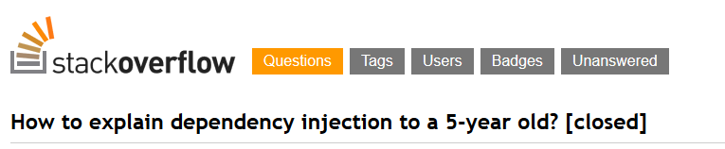
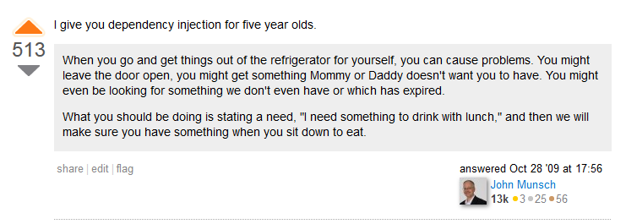
http://stackoverflow.com/questions/1638919/how-to-explain-dependency-injection-to-a-5-year-old/1638961#1638961

Slide 2

Dependency Injection, the right way
Thibaud DESODT
@tsimbalar
Notes:
Present you self

Slide 3
This talk
What it is about
Dependency Injection (DI) patterns
Benefits
Common pitfalls
What it is not about
Specific IoC/DI Container implementations
Pre-requisites
OOP
Class-based statically-typed languages
Based on examples
Notes:
Talk about Dependency Injection
Dependency Injection patterns
You may know about it under a form or another, or ay have used tools
Who has ?
You must unlearn ! Need to understand the philosophy and concepts in order to use the tools properly
It’s easy to misuse the tools and miss some benefits

Slide 4

Notes:
There is no magic !

Slide 5
Dependency Injection
What ?

Slide 6
Dependency Injection
Dependency Injection is a set of practices that allow to build loosely coupled applications

Slide 7
Dependency Injection
Dependency Injection is a set of practices that allow to build loosely coupled applications
It’s NOT :
A library
A framework
A tool
It IS :
A way of thinking
A way of designing code
General guidelines

Slide 8
Dependency Injection
Dependency Injection is a set of practices that allow to build loosely coupled applications
Small components …
Independent
Reusable
Interchangeable
… plugged together to form a bigger system
Benefits :
Small classes with single responsibility
Easier maintenance
Extensibility
Testable

Slide 9
From Tightly to Loosely Coupled
Show me the code !

Slide 10
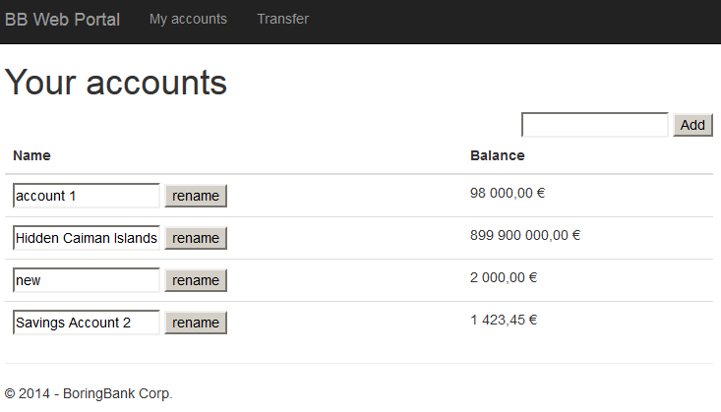
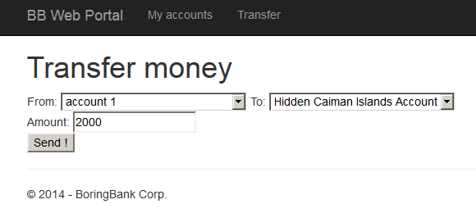
Example : Boring Bank™ System
Features
User can list his accounts
User can rename his accounts
User can transfer money from an account to the other
Tech :
Web front-end
Relational database

Slide 11
Starting from scratch
public class AccountController : BaseController
{
// GET: Account
[HttpGet]
public ActionResult Index()
{
var userId = this.User.AsClaimsPrincipal().UserId();
using (var context = new BankingDbContext())
{
var accounts = context.Accounts
.Where(a => a.CustomerId == userId)
.OrderBy(a => a.Title).ToList();
return View(accounts);
}
}
[HttpPost]
public ActionResult TransferPost(int from, int to, decimal amount)
{
var userId = this.User.AsClaimsPrincipal().UserId();
using (var context = new BankingDbContext())
{
var accountFrom = context.Accounts
.Single(a => a.CustomerId == userId && a.Id == from);
var accountTo = context.Accounts
.Single(a => a.CustomerId == userId && a.Id == to);
accountFrom.Balance -= amount;
accountTo.Balance += amount;
context.SaveChanges();
return RedirectToAction("Index");
}
}
data
business
presentation
Notes:
Let’s see …
Inside a controller
Creating a dbcontext (Entity Framework) … imagine if that was ADO .NET
Selecting a few things
Passing it to the view…
Has anybody ever written code like that ?
That’s only a read page … imagine action with side effects…
Simplified, no error handling whatsoever
You may argue that it is loosely coupled … there’s only one class … but what a class !

Slide 12
Tightly-coupled code
Using another kind of UI ?
Using another kind of storage ?
Using the business rules somewhere else ?

Slide 13
Separation of Concerns
Layered architecture / split assemblies
Presentation
Business
Data-access (Repository)
Separated :
Persistence Entities
Domain Entities
View Models
Notes:
Turned spaghetti into lasagna ☺

Slide 14
public class AccountController : BaseController
{
// GET: Account
[HttpGet]
public ActionResult Index()
{
var userId = this.User.AsClaimsPrincipal().UserId();
var userAccountService = new UserAccountService();
var accounts = userAccountService.GetAccountsForCustomer(userId);
return View(ToViewModel(accounts));
}
[HttpPost]
public ActionResult TransferPost(int from, int to, decimal amount)
{
var userId = this.User.AsClaimsPrincipal().UserId();
var userAccountService = new UserAccountService();
userAccountService.Transfer(userId, from, to, amount);
return RedirectToAction("Index");
}
AccountController.cs (WebPortal)
public Account GetAccountForCustomer(int customerId, int accountId)
{
using (var context = new BankingDbContext("BankingDbContext"))
{
var account = context.Accounts
.Single(a => a.CustomerId == customerId && a.Id == accountId);
return account;
}
}
public void Update(Account account)
{
using (var context = new BankingDbContext("BankingDbContext"))
{
var accountEf = context.Accounts.Find(account.Id);
// theoretically, could do "if not changed"
accountEf.Balance = account.Balance;
accountEf.Title = account.Title;
context.SaveChanges();
}
}
AccountRepository.cs (Data)
public void Transfer(int userId, int fromAccountId, int toAccountId, decimal amountToTransfer)
{
// TODO : validate arguments
var accountRepository = new AccountRepository();
var fromAccount = accountRepository.GetAccountForCustomer(userId, fromAccountId);
var toAccount = accountRepository.GetAccountForCustomer(userId, toAccountId);
// TODO : verify that there is enough money
fromAccount.Balance -= amountToTransfer;
toAccount.Balance += amountToTransfer;
accountRepository.Update(fromAccount);
accountRepository.Update(toAccount);
}
UserAccountService.cs (Business)
UI talks to Business
Business talks to Data

Slide 15
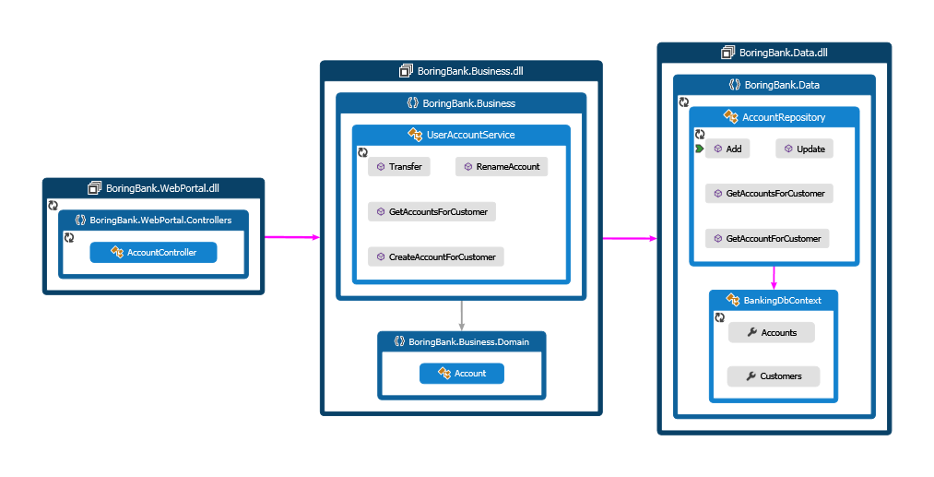
That looks fine … but is it ?
Notes:
Business depends on Data layer … it should be an implementation detail
Presentation depends on Business which depends on Data … which depends on EF … we’ll see that a bit later
But mostly about using components in isolation … this is not testable right now

Slide 16
anti-pattern : Control Freak
Symptoms:
Code insists on how the dependencies are built
Makes it impossible to use component in isolation
Not testable without full stack
Easy to spot : new everywhere
public class AccountController : BaseController
{
// GET: Account
[HttpGet]
public ActionResult Index()
{
var userId = this.User.AsClaimsPrincipal().UserId();
var userAccountService = new UserAccountService();
var accounts = userAccountService.GetAccountsForCustomer(userId);
return View(ToViewModel(accounts));
}
[HttpPost]
public ActionResult TransferPost(int from, int to, decimal amount)
{
var userId = this.User.AsClaimsPrincipal().UserId();
var userAccountService = new UserAccountService();
userAccountService.Transfer(userId, from, to, amount);
return RedirectToAction("Index");
}
AccountController.cs (WebPortal)
public void Transfer(int userId, int fromAccountId, int toAccountId, decimal amountToTransfer)
{
// TODO : validate arguments
var accountRepository = new AccountRepository();
var fromAccount = accountRepository.GetAccountForCustomer(userId, fromAccountId);
var toAccount = accountRepository.GetAccountForCustomer(userId, toAccountId);
// TODO : verify that there is enough money
fromAccount.Balance -= amountToTransfer;
toAccount.Balance += amountToTransfer;
accountRepository.Update(fromAccount);
accountRepository.Update(toAccount);
}
UserAccountService.cs (Business)

Slide 17
Unit tests as a Coupling Detector
Unit tests are “just another client” for your code
If unit tests are hard to write, the code is probably too tightly coupled
-> Let’s make it testable !
Notes:
Comment :
First encounter with need for loosely coupled code came from unit tests
Who write unit tests here ? Anybody who writes unit tests first ?
First encounter where you code MUST BE loosely coupled : unit tests ! Actually consume components out of the scope of the application
Tightly coupled code is hard to test or not testable at all … if it’s testable it’s not too tightly coupled

Slide 18
Making it testable - Properties
public class UserAccountService
{
public UserAccountService()
{
AccountRepository = new AccountRepository("BankingContext");
}
#region Dependency Management
public AccountRepository AccountRepository { get; set; }
#endregion
[TestMethod]
public void RenameAccount_must_UpdateAccountName()
{
// Arrange
var newName = "someName";
var existingAccount = AnAccount();
var sut = new UserAccountService();
sut.AccountRepository = FAIL FAIL//I want to put a fake here !
// Act
sut.RenameAccount(existingAccount.CustomerId, existingAccount.Id, newName);
// Assert
// I want to verify what happened ..
}
In UserAccountServiceTest.cs , in test project Business.Tests
Settable property allows
to “inject” another instance

Slide 19
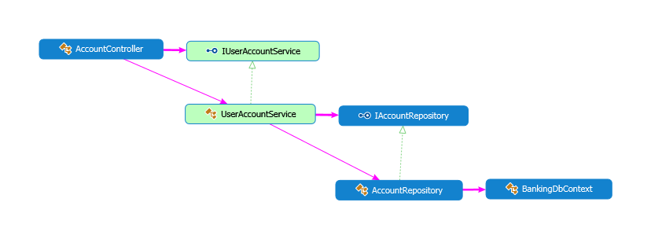
Programming to an interface
public class UserAccountService : IUserAccountService
{
public UserAccountService()
{
AccountRepository = new AccountRepository("BankingContext");
}
#region Dependency Management
public IAccountRepository AccountRepository { get; set; }
#endregion
[TestMethod]
public void RenameAccount_must_UpdateAccountName()
{
// Arrange
var newName = "someName";
var existingAccount = AnAccount();
var mockRepo = new Mock<IAccountRepository>();
mockRepo.Setup(r => r.GetAccountForCustomer(It.IsAny<int>(), It.IsAny<int>()))
.Returns(existingAccount);
var sut = new UserAccountService();
sut.AccountRepository = mockRepo.Object; //I want to put a fake here !
// Act
sut.RenameAccount(existingAccount.CustomerId, existingAccount.Id, newName);
// Assert
mockRepo.Verify(r=> r.Update(It.Is<Data.Account>(a=> a.Title == newName)));
}
Use an interface (or abstract class) instead of concrete class
Inject fake instance
Notes:
Interface of abstract class ….
I can’t do new I…..
The closest we can get is this ….
Note that even though we introduced interfaces, we still have a hard reference between all projects

Slide 20
pattern : Property Injection
Expose settable properties to modify dependencies
Benefits
Useful to provide optional extensibility
There must be a good “local default” implementation
Caveats
Not very easy to discover point of extension
Easy to forget
Extra care to avoid NullReferenceExceptions, handle thread-safety etc

Slide 21
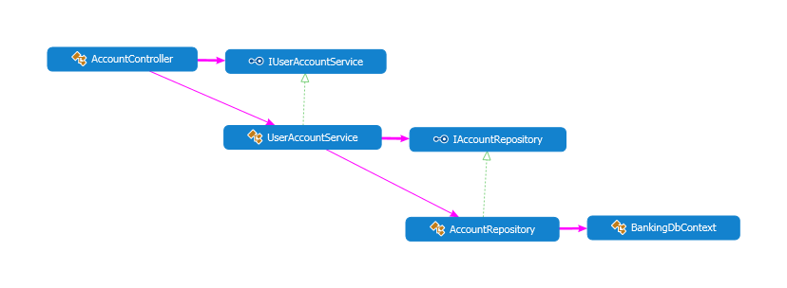
Making it more explicit - Constructor
public class UserAccountService : IUserAccountService
{
private readonly IAccountRepository _accountRepository;
public UserAccountService(IAccountRepository accountRepository)
{
if (accountRepository == null) throw new ArgumentNullException("accountRepository");
_accountRepository = accountRepository;
}
public UserAccountService()
:this(new AccountRepository("BankingContext"))
{
}
#region Dependency Management
public IAccountRepository AccountRepository { get { return _accountRepository; } }
#endregion
[TestMethod]
public void RenameAccount_must_UpdateAccountName()
{
// Arrange
var newName = "someName";
var existingAccount = AnAccount();
var mockRepo = new Mock<IAccountRepository>();
mockRepo.Setup(r => r.GetAccountForCustomer(It.IsAny<int>(), It.IsAny<int>()))
.Returns(existingAccount);
var sut = new UserAccountService(mockRepo.Object);
// Act
sut.RenameAccount(existingAccount.CustomerId, existingAccount.Id, newName);
// Assert
mockRepo.Verify(r=> r.Update(It.Is<Data.Account>(a=> a.Title == newName)));
}
Injection constructor
used in tests - declare required dependencies as constructor parameters
Default constructor
used in production code
Inject fake instance

Slide 22
anti-pattern : Bastard Injection
Enable dependencies for testing, but use hard-code implementation in production code
Paradox:
Lots of efforts to reduce coupling
… but forcing a hard-coded value
Test-specific code
Ambiguity
Notes:
Used in default Visual Studio Template for MVC apps until not so long ago

Slide 23
Cutting the dependency chain
public class AccountController : BaseController
{
private readonly IUserAccountService _userAccountService;
public AccountController(IUserAccountService userAccountService)
{
if (userAccountService == null) throw new ArgumentNullException("userAccountService");
_userAccountService = userAccountService;
}
AccountController (WebPortal)
public class UserAccountService : IUserAccountService
{
private readonly IAccountRepository _accountRepository;
public UserAccountService(IAccountRepository accountRepository)
{
if (accountRepository == null) throw new ArgumentNullException("accountRepository");
_accountRepository = accountRepository;
}
UserAccountService.cs (Business)
Only 1 constructor - dependencies passed as constructor arguments
Notes:
Comment about moving the interface into business
Where to put the interface ? Separate project “Abstractions” ? The consumer owns the interface

Slide 24
pattern : Constructor Injection
Declare required dependencies as constructor parameters
Declarative
Discoverable (Intellisense, Reflection …)
Recommended approach in 99.9% of cases
Easy to implement
Need Guard clause because C# does not support non-nullable reference types …
Notes:
If you remember one thing, it’s that !

Slide 25
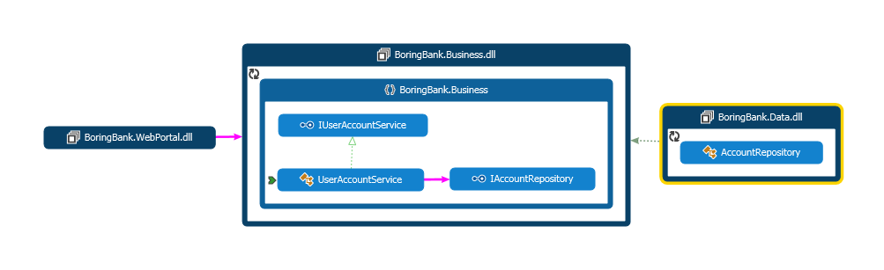
Inverted depency

Slide 26
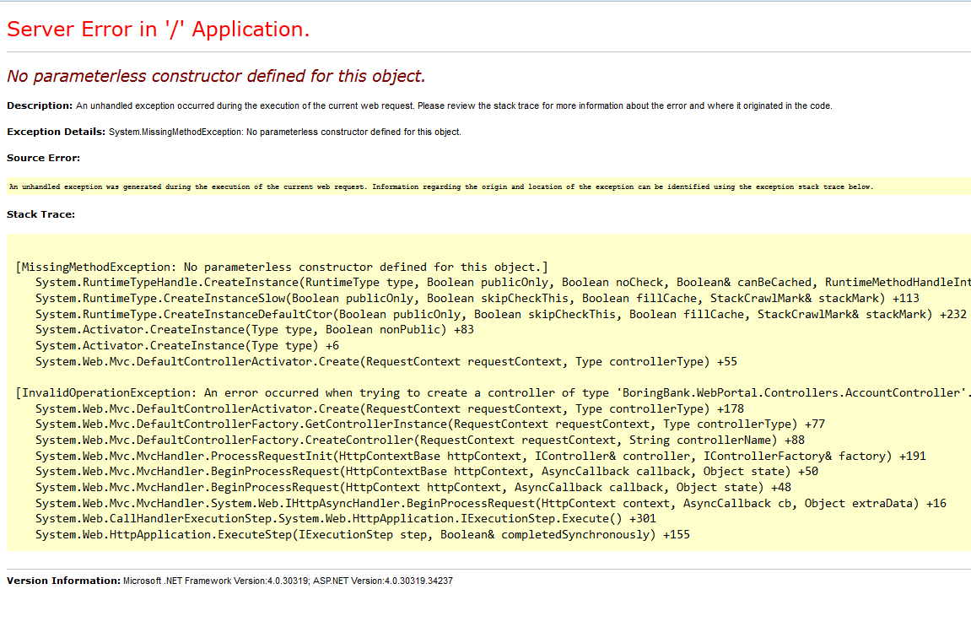
This is great and everything except …
[InvalidOperationException: An error occurred when trying to create a controller of type 'BoringBank.WebPortal.Controllers.AccountController'. Make sure that the controller has a parameterless public constructor.]
System.Web.Mvc.DefaultControllerActivator.Create(RequestContext requestContext, Type controllerType) +178
System.Web.Mvc.DefaultControllerFactory.GetControllerInstance(RequestContext requestContext, Type controllerType) +77
System.Web.Mvc.DefaultControllerFactory.CreateController(RequestContext requestContext, String controllerName) +88

Slide 27
The chicken and the egg
IAccountRepository repo = new IAccountRepository();
Ideal world: Programming to interfaces
vs
Real world : applications do not work with only interfaces
Class instances have to be created and assembled (=composed) at some point
This happens only in one place in an application

Slide 28
pattern : Composition Root
Composition of classes into a larger system should happen only in one place
Create one object-graph
As late as possible
Only part of the code that can reference concrete types
Where ?
Only applications have a Composition Root
There is no Composition Root in a class library
Extension point depends on the kind of app

Slide 29
ASP.NET MVC Composition Root
public class AppCompositionRoot : DefaultControllerFactory
{
protected override IController GetControllerInstance(RequestContext requestContext,
Type controllerType)
{
// how to compose an AccountController ?
if (controllerType == typeof(AccountController))
{
var connectionString = ConfigurationManager
.ConnectionStrings["BankingDbContext"].ConnectionString;
var repo = new AccountRepository(connectionString);
var service = new UserAccountService(repo);
return new AccountController(service);
}
// standard way in MVC to use default strategy
return base.GetControllerInstance(requestContext, controllerType);
}
}
IControllerFactory
Called on each request to create an instance of a controller matching URL
DefaultControllerFactory expects default constructor on Controller
… but it can be changed !
public class MvcApplication : System.Web.HttpApplication
{
protected void Application_Start()
{
var factory = new AppCompositionRoot();
ControllerBuilder.Current.SetControllerFactory(factory);
In Global.asax
Controller
composition
tell MVC to use our composition root
Notes:
Top down

Slide 30
Pure DI (aka Poor Man’s DI)
Manual wiring of dependencies
Very explicit (no « magic »)
Type-safe
… but repetitive and boring
var connectionString = ConfigurationManager
.ConnectionStrings["BankingDbContext"].ConnectionString;
var repo = new AccountRepository(connectionString);
var service = new UserAccountService(repo);
return new AccountController(service);

Slide 31
So what ?
And we did that because … ?

Slide 32
Benefits of full DI-friendly codebase
Testability
Maintainability
Allows parallel work
… and more !
Defined in a centralized location

Slide 33
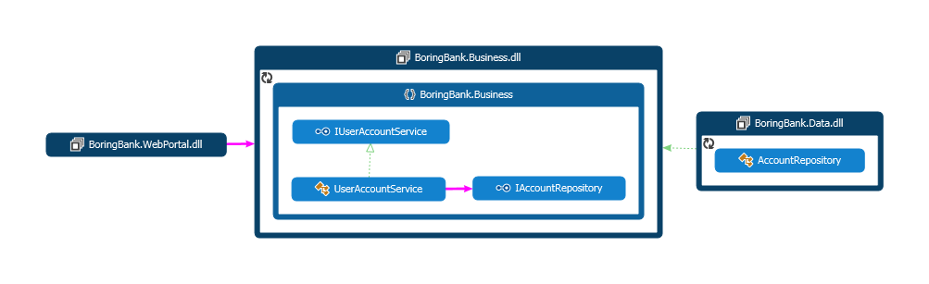
Reusability / Extensibility
or CLI
or WPF
or Web API
or WCF
…
or files
or NoSQL
or Azure
or Http Client
…

Slide 34
Late-binding
Dynamically decide which implementation to use
protected override IController GetControllerInstance(RequestContext requestContext,
Type controllerType)
{
// how to compose an AccountController ?
if (controllerType == typeof(AccountController))
{
var repo = LoadInstanceFromPluginFolder<IAccountRepository>();
var service = new UserAccountService(repo);
return new AccountController(service);
}
// standard way in MVC to use default strategy
return base.GetControllerInstance(requestContext, controllerType);
}
Plugin scenarios – scan assemblies in a folder for implementations

Slide 35
Extensibility
var nakedRepo = new AccountRepository(connectionString);
// decorate the nakedRepository with caching features
var longCache = new DotNetCache(TimeSpan.FromHours(1));
var cachedRepo = new CachedAccountRepository(longCache, nakedRepo);
var service = new UserAccountService(cachedRepo);
public class CachedAccountRepository : IAccountRepository
{
private readonly ICache _cache;
private readonly IAccountRepository _decorated;
public CachedAccountRepository(ICache cache, IAccountRepository decorated)
{
if (cache == null) throw new ArgumentNullException("cache");
if (decorated == null) throw new ArgumentNullException("decorated");
_cache = cache;
_decorated = decorated;
}
public IReadOnlyList<Account> GetAccountsForCustomer(int userId)
{
var accounts = _cache.GetOrAdd("accounts_" + userId,
() => _decorated.GetAccountsForCustomer(userId));
return accounts;
}
Decorator
Decorator Pattern
Very DI-friendly pattern
Example : caching
delegate to decorated instance
Notes:
Traditionnal approach would be :
Modify code
Subclass..

Slide 36
DI COntainers

Slide 37
DI Container – how they work
Mapping Abstraction-> Concrete Type
Usually initialized on app start
Methods like Register<IAbstraction,ConcreteType>()
Method Resolve<TRequired>()
Recursively resolves dependencies reading constructor parameters

Slide 38
Example - Unity
public class DependencyConfig
{
public static void Configure(IUnityContainer container)
{
var connectionString = ConfigurationManager.ConnectionStrings["BankingDbContext"]
.ConnectionString;
container.RegisterType<IAccountRepository, AccountRepository>(
new InjectionConstructor(connectionString));
container.RegisterType<IUserAccountService, UserAccountService>();
}
}
In DependencyConfig
public class MvcApplication : System.Web.HttpApplication
{
protected void Application_Start()
{
var container = new UnityContainer();
DependencyConfig.Configure(container);
var compositionRoot = new AppCompositionRoot(container);
ControllerBuilder.Current.SetControllerFactory(compositionRoot);
In Global.asax
public class AppCompositionRoot : DefaultControllerFactory
{
private readonly IUnityContainer _unityContainer;
public AppCompositionRoot(IUnityContainer unityContainer)
{
if (unityContainer == null) throw new ArgumentNullException("unityContainer");
_unityContainer = unityContainer;
}
protected override IController GetControllerInstance(RequestContext requestContext, Type controllerType)
{
return (IController) _unityContainer.Resolve(controllerType);
}
}
In CompositionRoot
Register / Resolve (/ Release)

Slide 39
Aspects of DI
Composition
Lifetime Management
Interception

Slide 40
Interception
~ Dynamic Decorators
Cross-cutting concerns
Logging
Auditing
Profiling …
AOP-like !

Slide 41
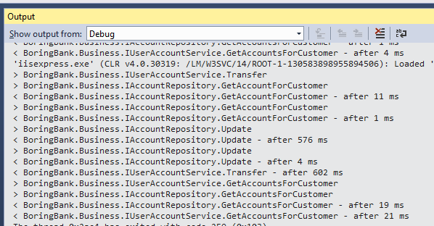
public class TimingBehavior : IInterceptionBehavior
{
public IMethodReturn Invoke(IMethodInvocation input, GetNextInterceptionBehaviorDelegate getNext)
{
var stopwatch = new Stopwatch();
// Before invoking the method on the original target.
Debug.WriteLine("> {0}.{1}", input.MethodBase.DeclaringType, input.MethodBase.Name);
stopwatch.Start();
// Invoke the next behavior in the chain.
var result = getNext()(input, getNext);
stopwatch.Stop();
// After invoking the method on the original target.
if (result.Exception != null)
{
Debug.WriteLine(
"< {0}.{1} failed - after {3} ms",
input.MethodBase.DeclaringType, input.MethodBase.Name, result.Exception.GetType(), stopwatch.ElapsedMilliseconds);
}
else
{
Debug.WriteLine("< {0}.{1} - after {2} ms",
input.MethodBase.DeclaringType, input.MethodBase.Name,
stopwatch.ElapsedMilliseconds);
}
return result;
}
Before each method call of decorated class
public class DependencyConfig
{
public static void Configure(IUnityContainer container)
{
container.AddNewExtension<Interception>();
var connectionString = ConfigurationManager.ConnectionStrings["BankingDbContext"]
.ConnectionString;
container.RegisterType<IAccountRepository, AccountRepository>(
new InjectionConstructor(connectionString),
new Interceptor<InterfaceInterceptor>(),
new InterceptionBehavior<TimingBehavior>());
container.RegisterType<IUserAccountService, UserAccountService>(
new Interceptor<InterfaceInterceptor>(),
new InterceptionBehavior<TimingBehavior>());
}
}
Call to decorated instance
After each method call

Slide 42
To conclude …

Slide 43
Things to remember
DI Patterns …
Don’t be a Control Freak
Constructor Injection is your friend
Compose you object graphs in one place
DI Containers are powerful but not magical
… can help you achieve loosely coupled code
Maintainable
Testable

Slide 44

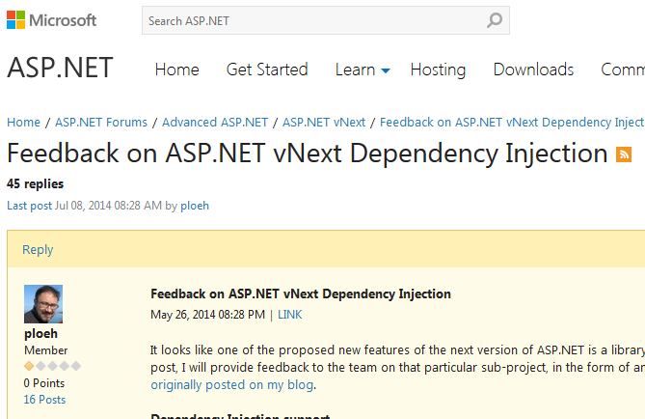
Going further …
Mark Seemann’s book and blog posts
http://blog.ploeh.dk/
Conversation about DI in aspnet vNext
http://forums.asp.net/t/1989008.aspx?Feedback+on+ASP+NET+vNext+Dependency+Injection
SOLID principles

Slide 45
Q&a
Shoot !

Slide 46
Thanks for attending !
Contact : @tsimbalar

Slide 47
EXTRAS
You want more ?

Slide 48
LifeTime Management

Slide 49
anti-pattern : Service Locator

Slide 50
SOLID
Single Responsibility Principle
Open Closed Principle
Liskov Substitution Principle
Interface Segregation Principle
Dependency Inversion Principe

